Slide 1

3PR
School Parking Initiative

Slide 2

3 Parking Rules
Care, Consideration and Caution

Slide 3


3PR’s Mission:
Eliminate dangerous parking outside of schools…

Slide 4

In January 2020 a little green robot called 3PR began his mission to help The Downs Primary School to eliminate dangerous parking
In order for 3PR to complete his mission we need the help of the pupils at The Downs Primary School.

Slide 5

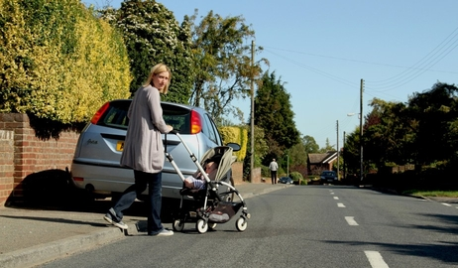
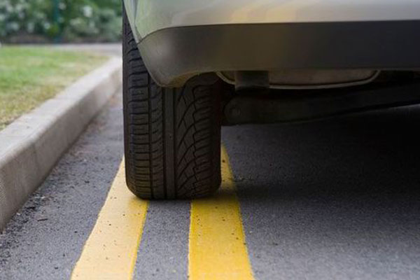
3PR’s Mission -
Remove inconsiderate parking outside of your school
Parking on the pavement
Parking on restrictions

Slide 6
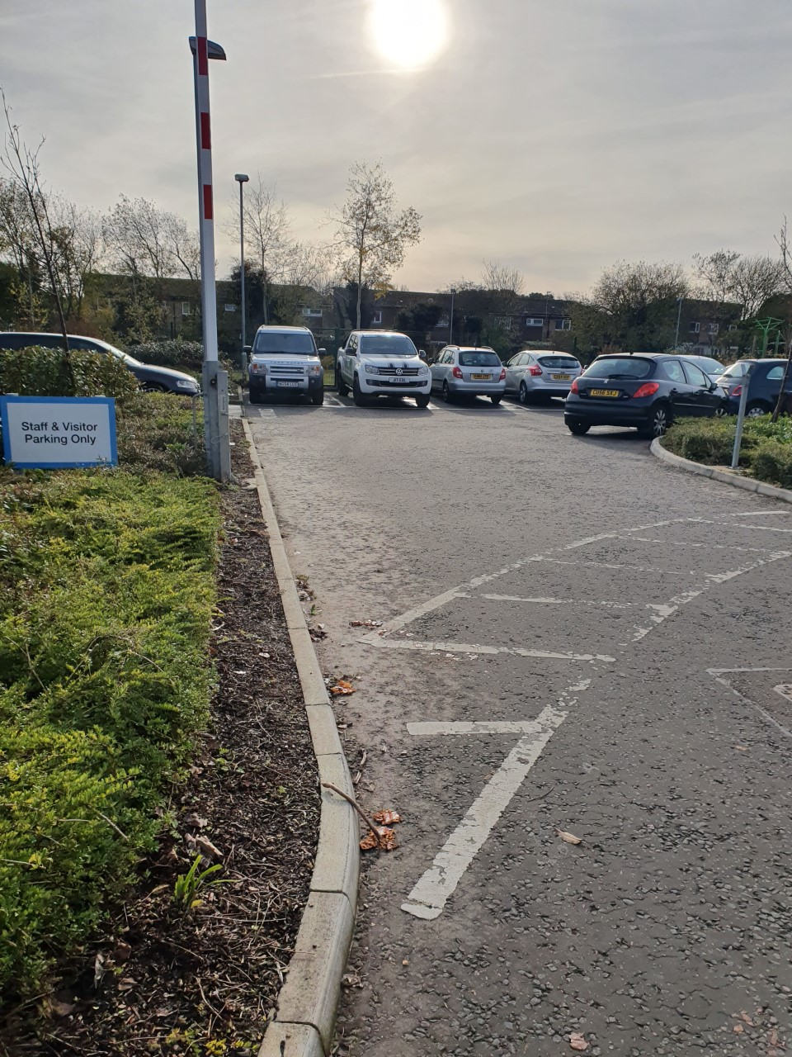
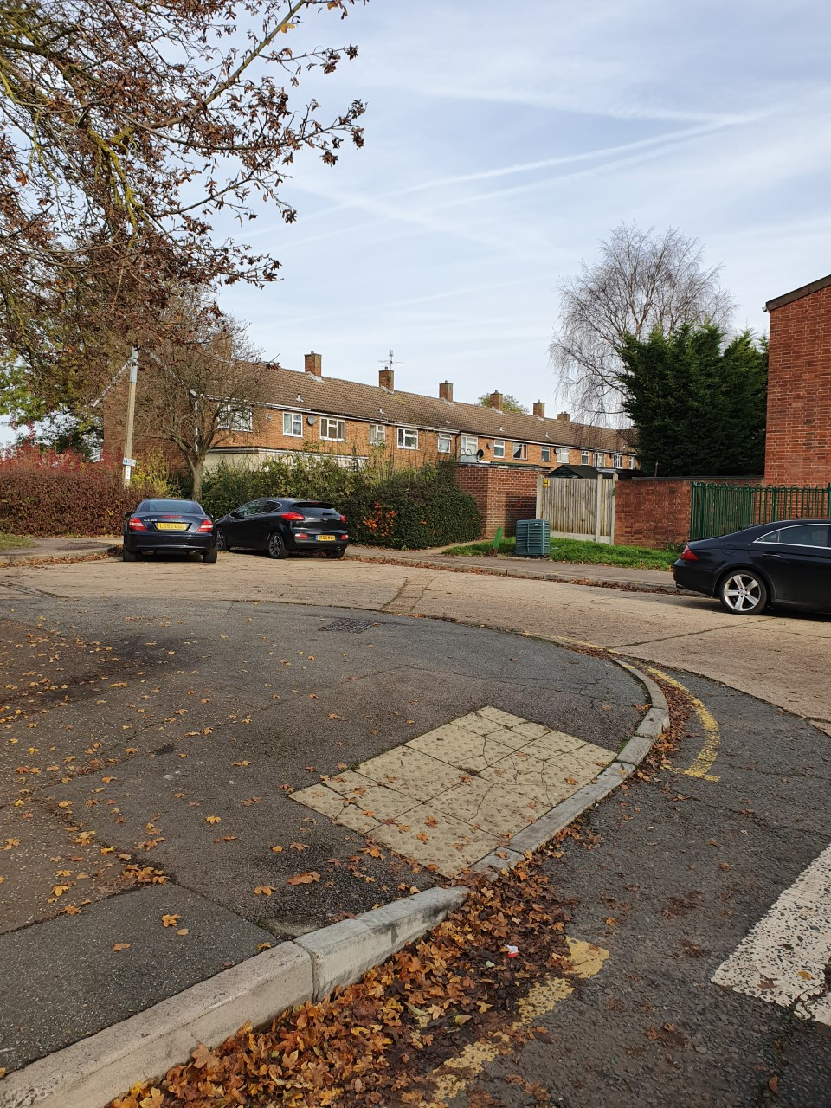
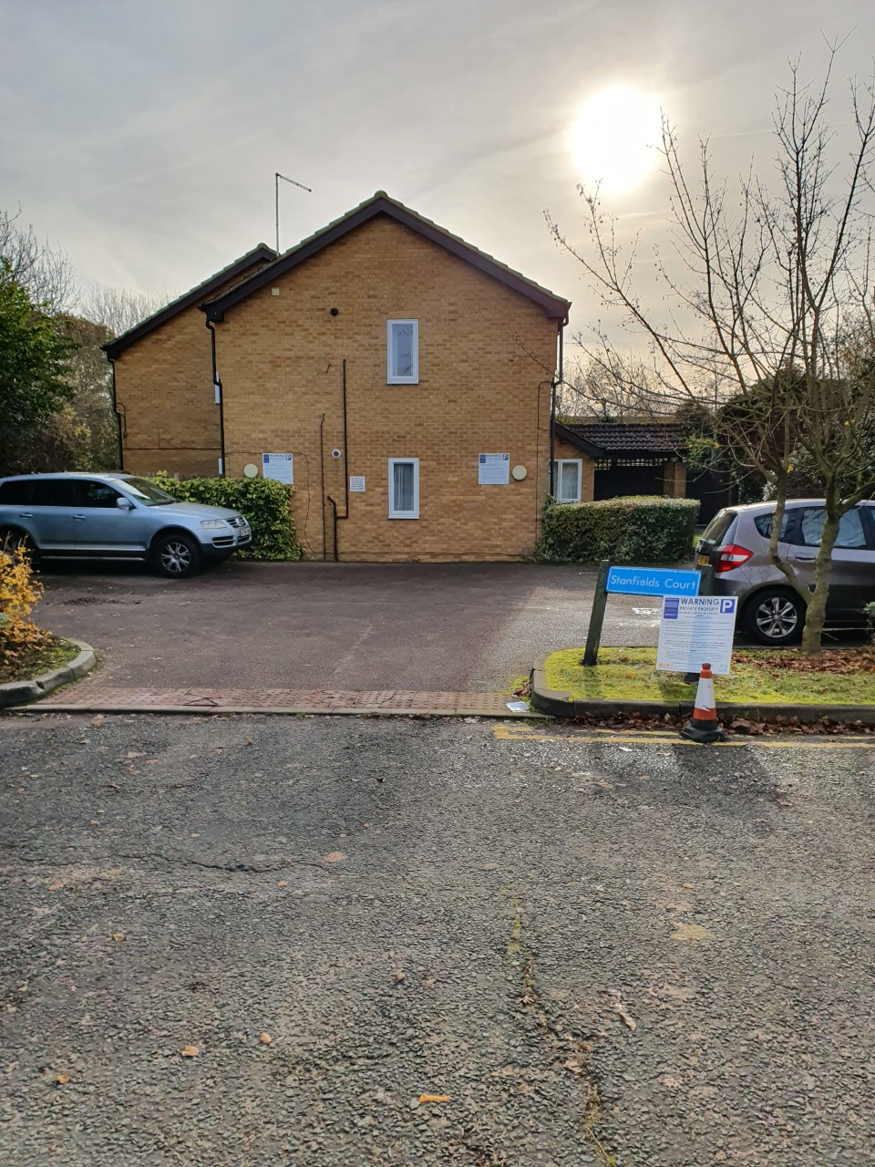
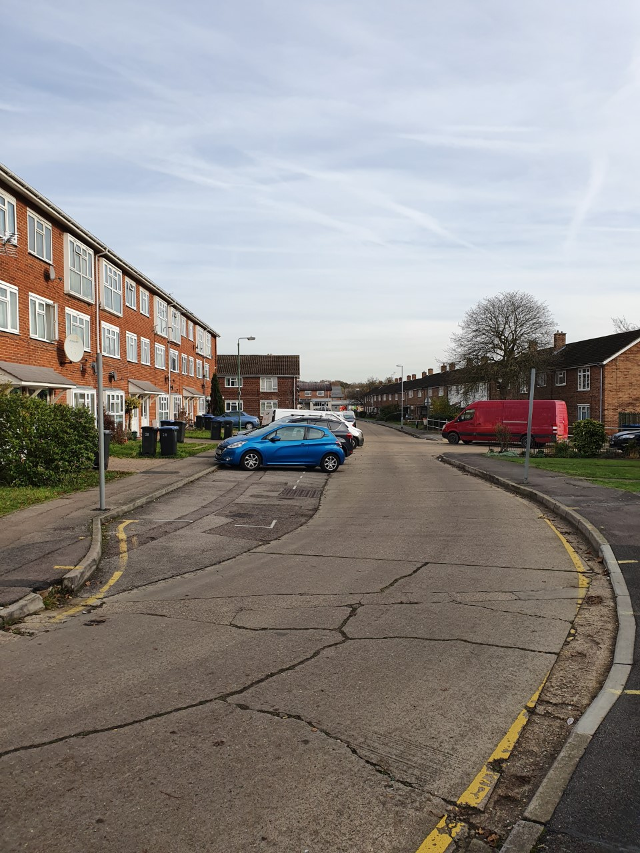
3PR’s Mission continued-
Places NOT to park

Slide 7
3PR School
Signs will be put up outside of your school, so everybody will know The Downs Primary School
is a 3PR school………….

Slide 8
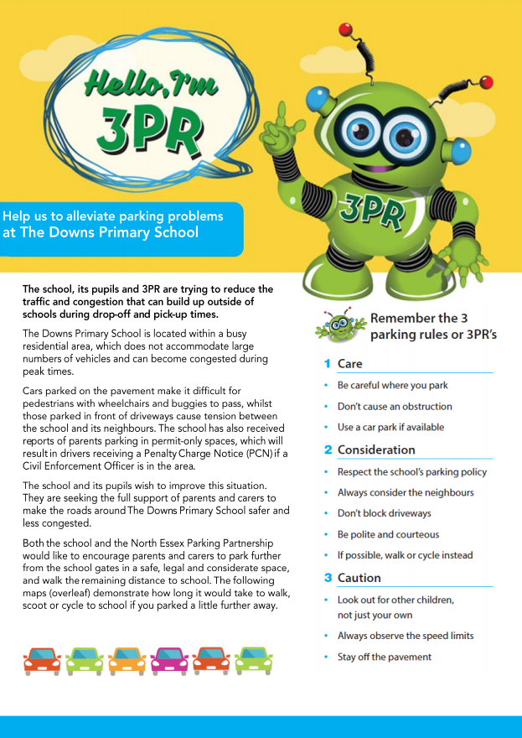

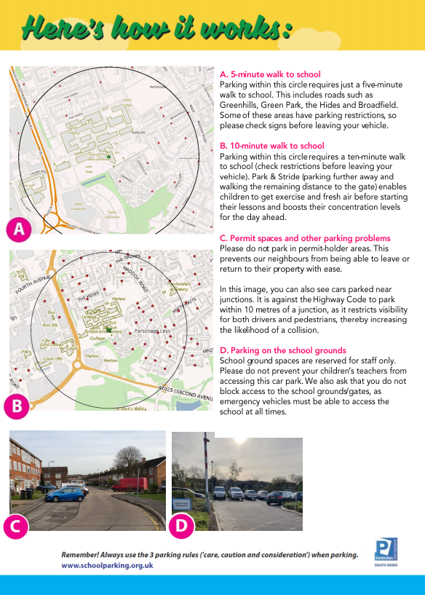
3PR Leaflets
&
Booklets

