Slide 1
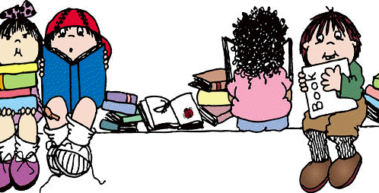
This Photo by Unknown Author is licensed under CC BY-NC-ND

Slide 2
Reading
Reading is a life skill that opens the door to the rest of our learning. Therefore a child needs to be able to decode and to comprehend a text that they are reading. The comprehending is fundamental.
Research shows that
Students who read the most, read the best, achieve the most and stay in education the longest.
Those who don’t read much, cant get better at it.

Slide 3
Reading in school
In school we are always reading and we read in all areas of the curriculum.
Independent reading (your child’s reading book should be closely matched to their reading ability and comprehension levels)
Library – every child should visit the library once a week. The book chosen is of the child’s choice and is an opportunity to look at a wider range of books.
Whole Class Reading
Drop Every Thing and Read.
In Years 1 and 2 we also continue with developing children’s phonic knowedge

Slide 4
Reading
Good readers go through a number of different processes when they read.
They should be able to self-monitor. Encourage your child to ask, “Does this make sense?”
If it doesn’t make sense then use these strategies:
Go back and reread
Read ahead to clarify meaning
Try to say what has happened previously so that they can make sense of the text.

Slide 5
Reading
Good readers use their background knowledge, this is everything they already know;
Their personal history
What they have read or seen before
Their experiences
Their likes and dislikes
We use our background knowledge to help us to understand what we are reading.

Slide 6
Reading
Visualising
Being able to visualise what is happening in a text is closely linked to your background knowledge. (you can’t visualise what you don’t know)
Children who are able to visualise the text generally comprehend much better.
We need to help children to visualise by showing them pictures of things that they might not yet know. How can you visualise an elephant if you have never seen one.

Slide 7
Reading
Infer
Being able to infer is an important life-skill
When reading we need to be able to infer to answer questions that
Read on the lines (are straight forward retrieval)
Read between the lines (what the author is implying by saying something)
Read beyond the lines. (explaining your opinion, based on your own experiences and background knowledge)

Slide 8
Reading Skills
During Whole Class Reading we teach a range of strategies and skills so that the children are equipped to answer different types of questions.
We also read a range of fiction, non-fiction and poetry.
Children will be taught to answer a range of questions using different strategies. They need to retrieve, predict, infer, sequence, comment on vocabulary and summarise.
In Years 1 and 2 these skills are taught and practised repeatedly.
Phonics is also important but being good at phonics is not the only part of reading.

Slide 9
End of Year 2 Expectations
Working at the expected standard
The pupil can:
• read accurately most words of two or more syllables
• read most words containing common suffixes*
• read most common exception words.*
In age-appropriate1 books, the pupil can:
• read most words accurately without overt sounding and blending, and sufficiently fluently to allow them to focus on their understanding rather than on decoding individual words2
• sound out most unfamiliar words accurately, without undue hesitation.
In a book that they can already read fluently, the pupil can:
• check it makes sense to them, correcting any inaccurate reading
• answer questions and make some inferences
• explain what has happened so far in what they have read.

Slide 10
End of Year2 expectations
This child is reading at the expected level for end of year 2.
They would also need to be able to answer a range of comprehension questions.
https://www.youtube.com/watch?v=w4c_DMS-3IE
Fluency is key as children need to be reading at around 75+ words per minute.

Slide 11
Reading to your child
Reading to your child is very important.
Research has typically found that shared reading experiences are highly beneficial for young people. Benefits of shared reading include enriched language exposure, fostering the development of listening skills, spelling, reading comprehension and vocabulary.
They are also valued as a shared social opportunity between parents and their children to foster positive attitudes toward reading.
Your child's reading experience is much more than the reading book which comes home from school. Reading is happening all the time in a classroom and in the school. It is taught in specific reading and English lessons, but children are practising and using their 'reading' constantly across all subjects too.

Slide 12
Parents can support this 'reading journey' through regular reading at home. Reading to and with your child every evening for at least ten minutes can make a dramatic difference to a child's achievement within school.
A report from the Oxford University Press highlighted the importance of parents reading with their children.
'Children who read outside of class are 13 times more likely to read above the expected level for their age'

Slide 13
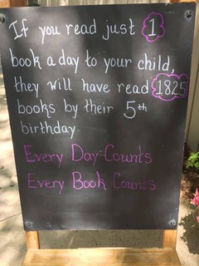
Read…….
If you read for 20 minutes every day you will read 1.8 million words a year.
Being fluent is really important. Read at over 75 words a minute.

Slide 14
Website
Our brand new website will be launched very soon.

