Slide 1
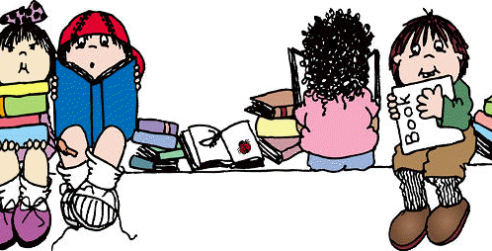
This Photo by Unknown Author is licensed under CC BY-NC-ND

Slide 2
Reading
Reading is a life skill that opens the door to the rest of our learning. Therefore a child needs to be able to decode and to comprehend a text that they are reading. The comprehending is fundamental.
Research shows that
Students who read the most, read the best, achieve the most and stay in education the longest.
Those who don’t read much, cant get better at it.

Slide 3
Reading in school
In school we are always reading and we read in all areas of the curriculum.
Independent reading (your child’s reading book should be closely matched to their reading ability and comprehension levels)
Library – every child should visit the library once a week. The book chosen is of the child’s choice and is an opportunity to look at a wider range of books.
Whole Class Reading
Drop Every Thing and Read.

Slide 4
Reading
Good readers go through a number of different processes when they read.
They should be able to self-monitor. Encourage your child to ask, “Does this make sense?”
If it doesn’t make sense then use these strategies:
Go back and reread
Read ahead to clarify meaning
Summarise what has happened so far

Slide 5
Reading
Good readers use their background knowledge, this is everything they already know;
Their personal history
What they have read or seen before
Their experiences
Their likes and dislikes
We use our background knowledge to help us to understand what we are reading.

Slide 6
Reading
Visualising
Being able to visualise what is happening in a text is closely linked to your background knowledge. (you can’t visualise what you don’t know)
Children who are able to visualise the text generally comprehend much better.

Slide 7
Reading
Infer
Being able to infer is an important life-skill
When reading we need to be able to infer to answer questions that
Read on the lines (are straight forward retrieval)
Read between the lines (what the author is implying by saying something)
Read beyond the lines. (explaining your opinion, based on your own experiences and background knowledge)

Slide 8
Reading Skills
During Whole Class Reading we teach a range of strategies and skills so that the children are equipped to answer different types of questions.
We also read a range of fiction, non-fiction and poetry.
The types of questions the children could be asked involve, retrieval, predicting, summarising, inferring, sequencing, vocabulary and discussing the author’s language choices.

Slide 9
End of Year 6 Expectations
•read age-appropriate books with confidence and fluency (including whole novels)
•read aloud with intonation that shows understanding
•work out the meaning of words from the context
•explain and discuss their understanding of what they have read, drawing inferences and justifying these with evidence
•predict what might happen from details stated and implied
•retrieve information from non-fiction
•summarise main ideas, identifying key details and using quotations for illustration
•evaluate how authors use language, including figurative language, considering the impact on the reader
•make comparisons within and across books.

Slide 10
Year 6 Reading Sats
Reading – one paper
The KS2 reading test is only one paper, containing comprehension questions based on three different genres of text. The test has a reading booklet and a separate answer booklet. Children will have one hour to read all three texts and complete the questions, which are worth a total of 50 marks.
The children need to be fluent readers so that they can read the text confidently in the time given.
Music Box was last year’s fiction text.

Slide 11
Reading to your child
Reading to your child even in Year 5 and 6 is very important.
Research has typically found that shared reading experiences are highly beneficial for young people. Benefits of shared reading include enriched language exposure, fostering the development of listening skills, spelling, reading comprehension and vocabulary.
They are also valued as a shared social opportunity between parents and their children to foster positive attitudes toward reading.
Your child's reading experience is much more than the reading book which comes home from school. Reading is happening all the time in a classroom and in the school. It is taught in specific reading and English lessons, but children are practising and using their 'reading' constantly across all subjects too.

Slide 12
Parents can support this 'reading journey' through regular reading at home. Reading to and with your child every evening for at least ten minutes can make a dramatic difference to a child's achievement within school.
A report from the Oxford University Press highlighted the importance of parents reading with their children.
'Children who read outside of class are 13 times more likely to read above the expected level for their age'

Slide 13
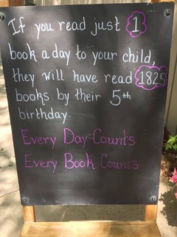
Read…….
If you read for 20 minutes every day you will read 1.8 million words a year.

Slide 14
Website
Our brand new website will be launched very soon.

